Slide 1
Funnels with Warby Parker
Learn SQL from Scratch
Jamaal Lewis
07/30/2018

Slide 2
Table of Contents
Get familiar with Warby Parker
What is the Quiz Funnel
A/B Testing with Home Try-On Funnel

Slide 3
1.Get familiar with Warby Parker

Slide 4
1.1 Tables within Warby Parker Database
Here are the tables within Warby Parker’s Database
Quiz | Home Try On | Purchase | Survey
User ID | User ID | User ID | Question
Style | Number of Pairs | Product ID | User ID
Fit | Address | Style | Response
Shape |  | Model Name
Color |  | Color
 |  | Price

Slide 5
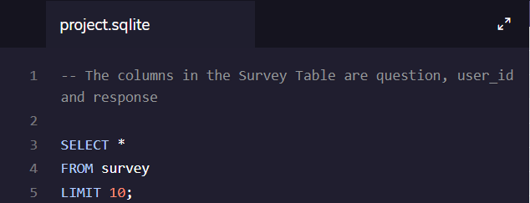
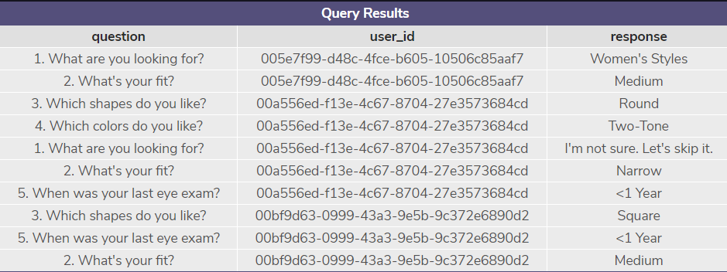
What columns does the table have?
The word “SELECT” is used to query data from the database.
FROM tells us which table we are taking the data from.
LIMIT is a clause that lets us be specify regarding the maximum number of rows in the result set.

Slide 6
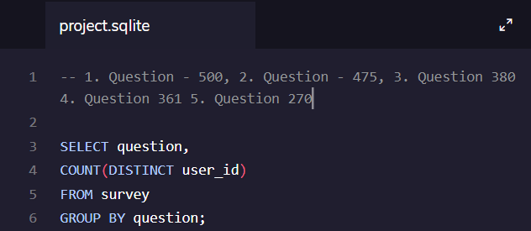
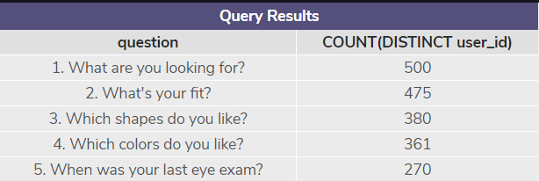
What is the number of responses for each question?
By using Distinct, we eliminate multiple/ same results in a column and brings up one.
We could also use GROUP BY ‘1’ to describe the first column in SELECT

Slide 7
2. What is the Quiz Funnel
Notes:
Home try on’s to purchase

Slide 8
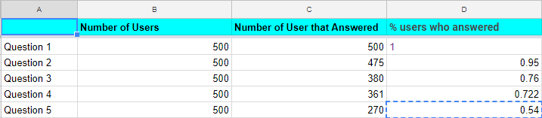
Using Spreadsheet Program to calculate.
Which question(s) of the quiz have a lower completion rates?
Question #5 has the lower completion rates.
What do you think is the reason?
I think people don’t remember or don’t care to answer when their last eye exam was.

Slide 9
3. A/B Testing with Home Try-On Funnel

Slide 10
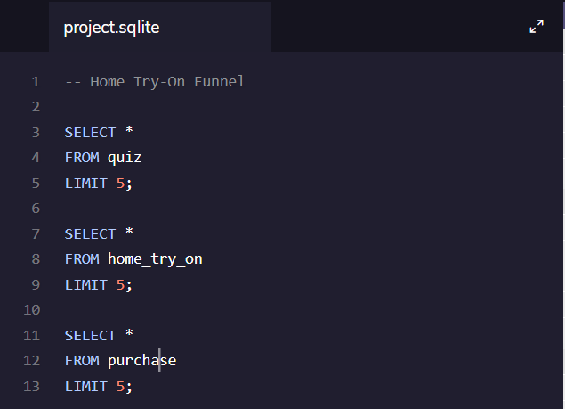
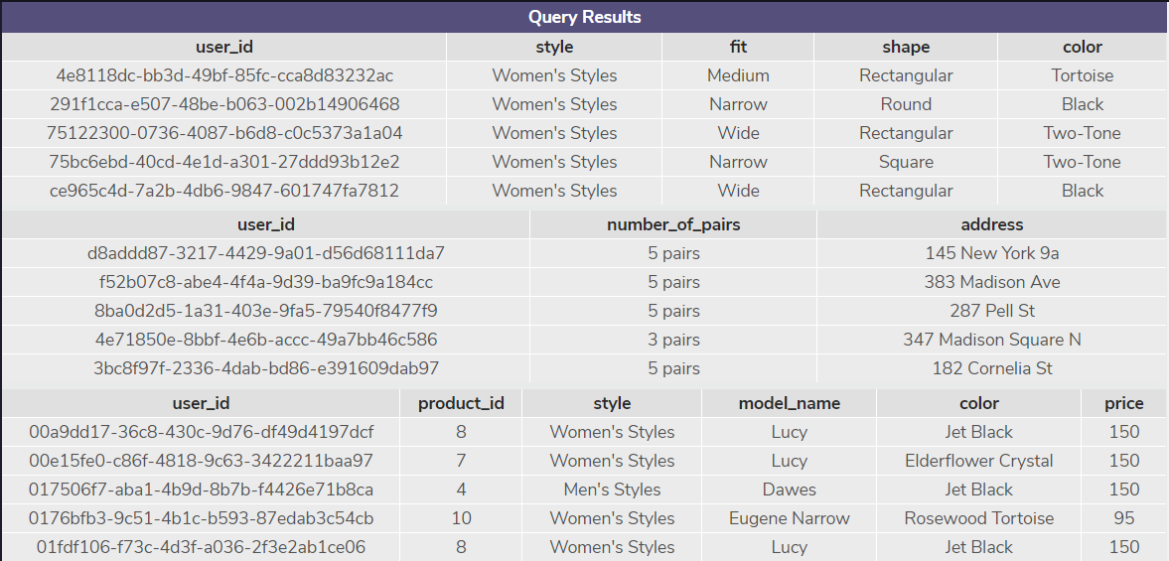
What are the column name?
Once again, by using SELECT, FROM and LIMIT, we are able to create a funnel and find out what all the columns are in each table.

Slide 11
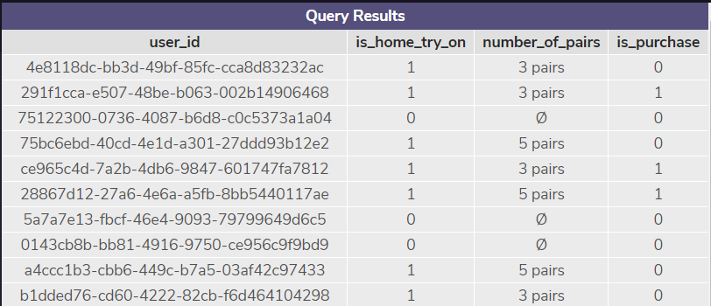
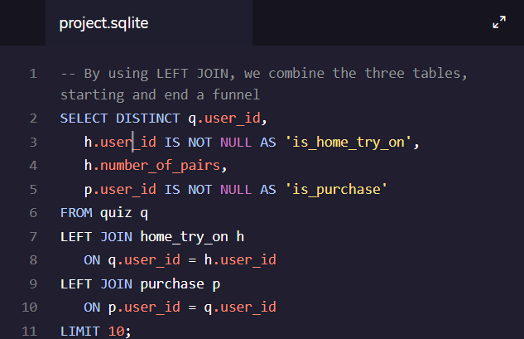
Using LEFT JOIN in a Funnel
The LEFT JOIN returns all records from the left table (table 1) and the matched records from the right table (table 2). The result is NULL from the right side, if there is no match.

Slide 12
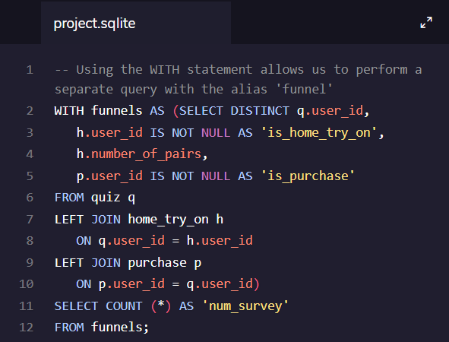

Analyzing data in several ways
Using the WITH statement, we’re able to find overall conversion rate.

Slide 13
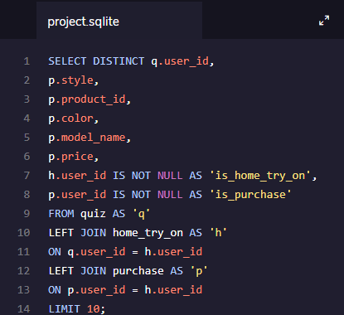
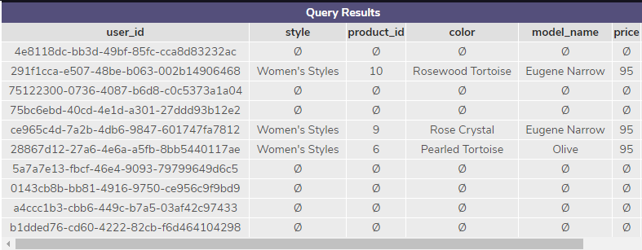
The most common type of purchase was Women’s Style frames at $95

Slide 14
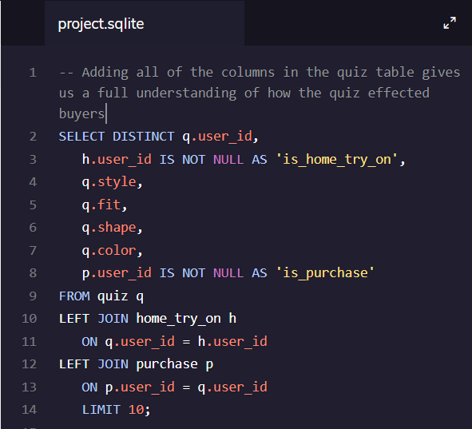
The most common results of the style quiz

Slide 15
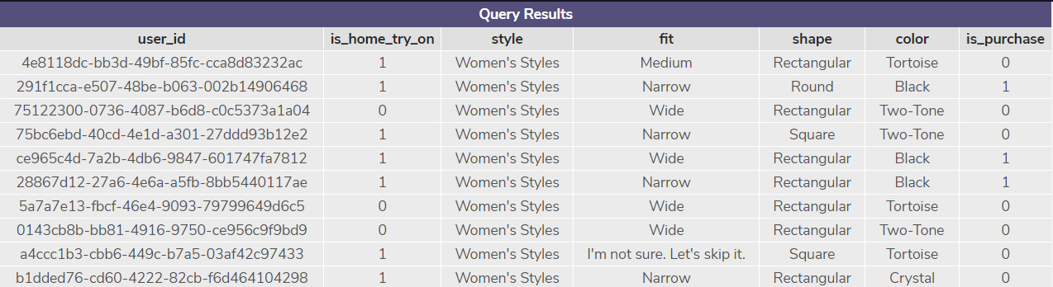
The most common results of the style quiz
The quiz results show that women made up majority of the quiz takes. They also enjoyed Rectangular shaped frames.

Slide 16
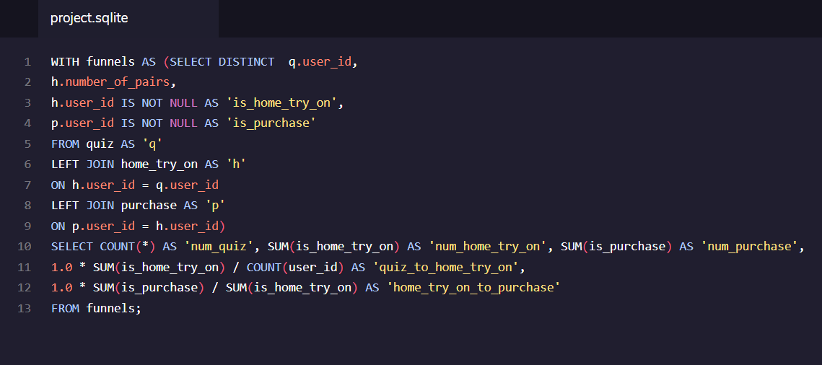

Comparing conversions from quiz > home_try_on and home_try_on > purchase

